Slide 1
Stack overflow Extraction
Ariel Blobstein

Slide 2
Contents
Overview
Code Summary
Example
Rules
Further Work

Slide 3
Overview
The following presentation describes a project that extracts, and maps posts in Java from the stack overflow forum.
The extraction is mainly written in python, while there is an option to include java code diagnostics written in java to handle compilation errors.
The mapping is based on a Java parser using javalang python module, while the code is mapped by identifying java tokens.
The meta model transformation is written in Eclipse epsilon framework.

Slide 4
Code summary
dataCollector :
connects to the bigquery dataset and extracts panda data frame.
codeExtractor:
Splits the data frame into 2 separate data frames of posts and posts answer.
Gather the meta data from the post aside the code and text: Score and tags.
Preprocess the code, remove wrong java syntax and fix them if possible.

Slide 5
Code summary
codeParser :
Parse the code extracted from the post question and answer (3 options: class wrapped code, method code and variable codes).
Creates task instance for every post answer that can be parsed.
Creates class task, method task and attribute task for each corresponding instance in the original code.
Connects between inheritance class tasks, and method calls tasks.
Merges the post answer’s code inside the post question’s code, and swap if needed.
Returns a dictionary containing all the queries answer, where the dictionary keys are the titles, and the values are the task instance for each answer.

Slide 6
Code summary
CodeWrapper :
Initiate the task instance.
Creates task instance for each query, class, method, enum and attribute.
MapCreator :
Creates a map for each query returned from the codeParser.

Slide 7
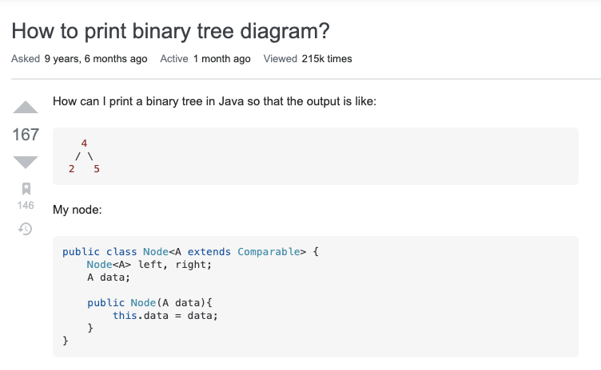
Example
An example for a post extraction.
Given the following stack overflow post:
how-to-print-binary-tree-diagram
We will pick 3 answers for example.
Post:

Slide 8
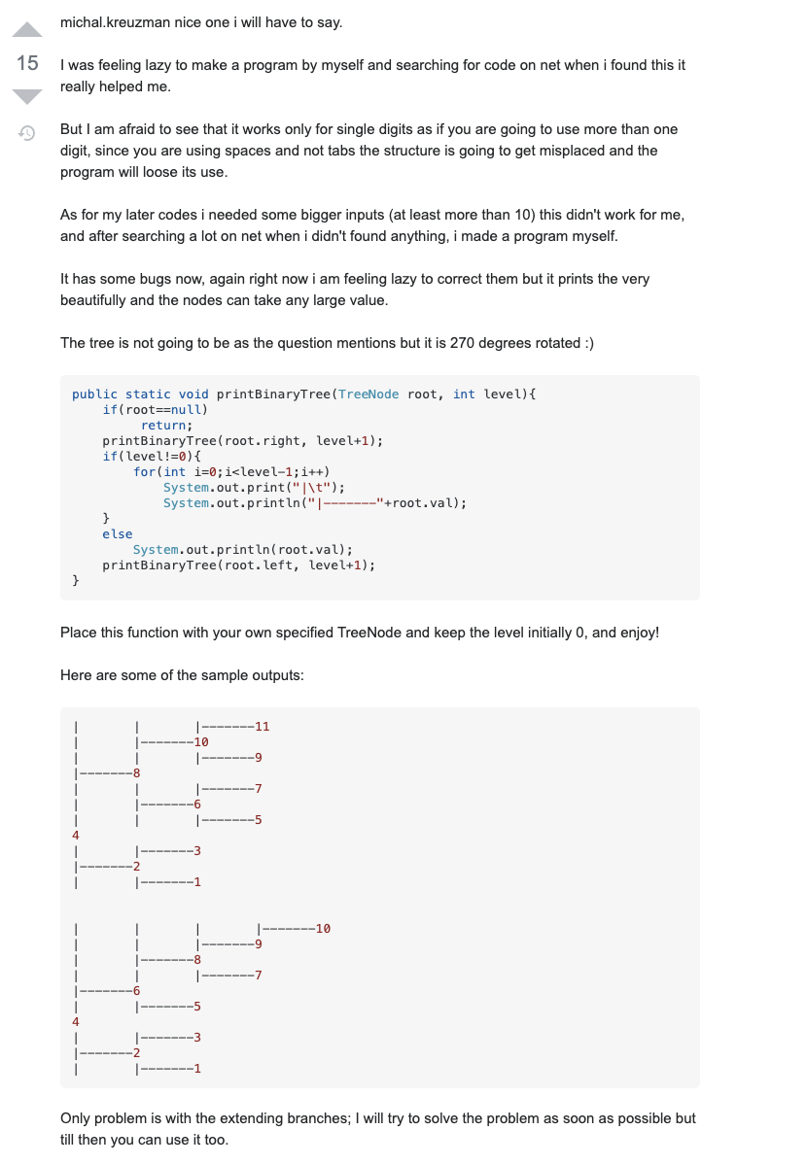
Example 1

Slide 9
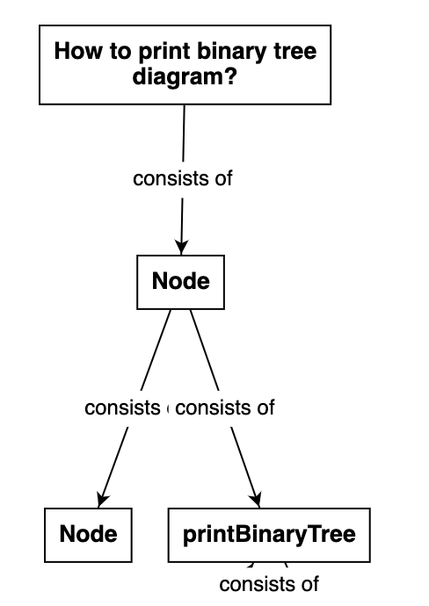
Example 1 – Map

Slide 10
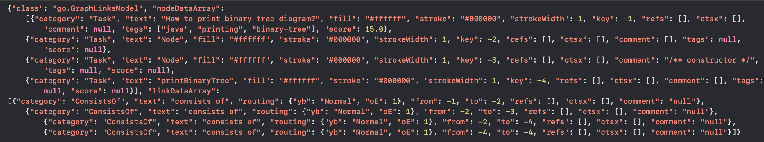
Example 1 – Json (without code and text)
Notes:
comments

Slide 11
Example 1 – Code

Slide 12
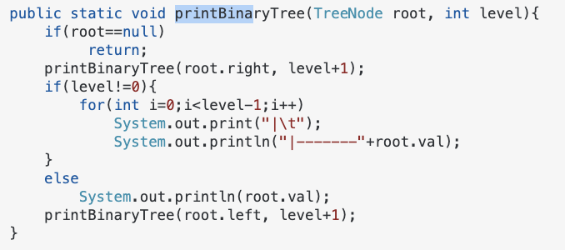
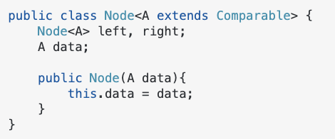
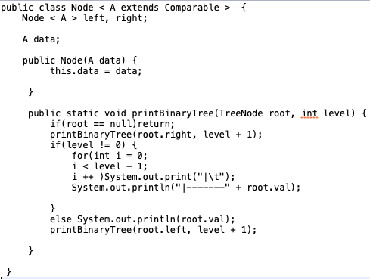

Slide 13
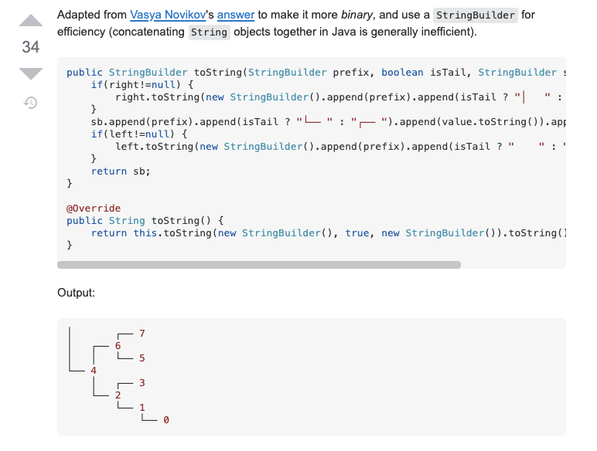
Example 2

Slide 14
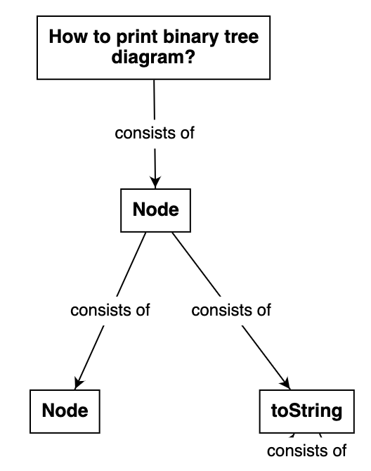
Example 2 - Map

Slide 15
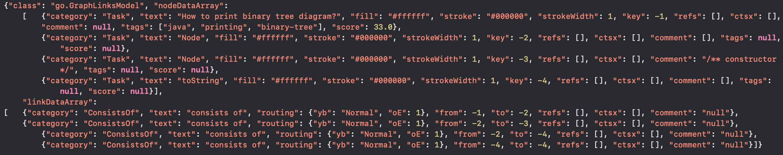
Example 2 - Json (without code and text)

Slide 16
Example 2 -Code

Slide 18
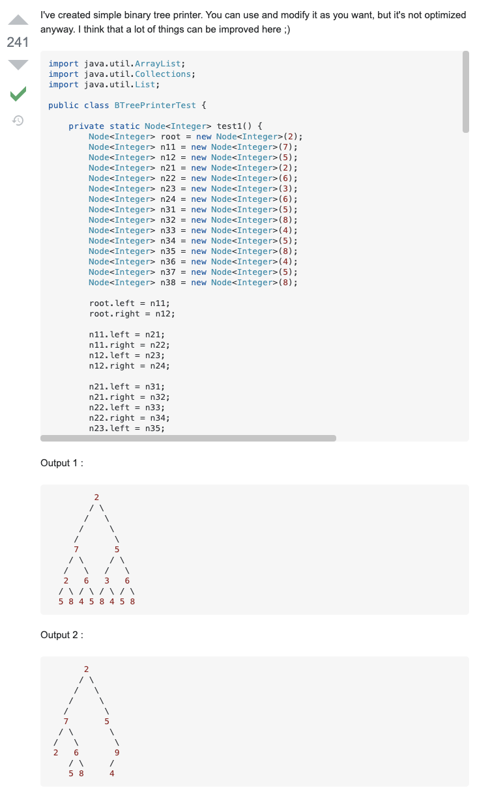
Example 3

Slide 19
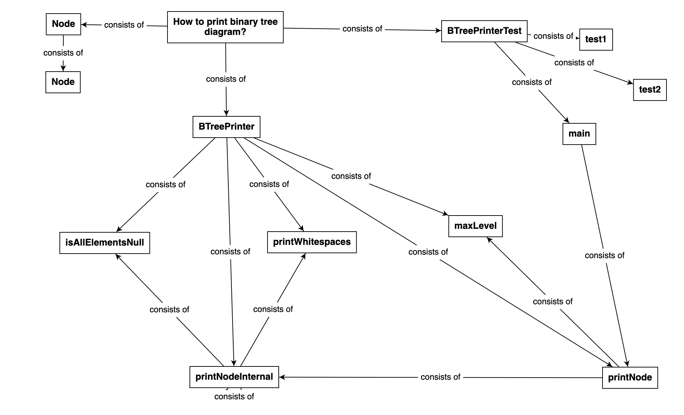
Example 3 - Map

Slide 20
Example 3 – Code

Slide 21
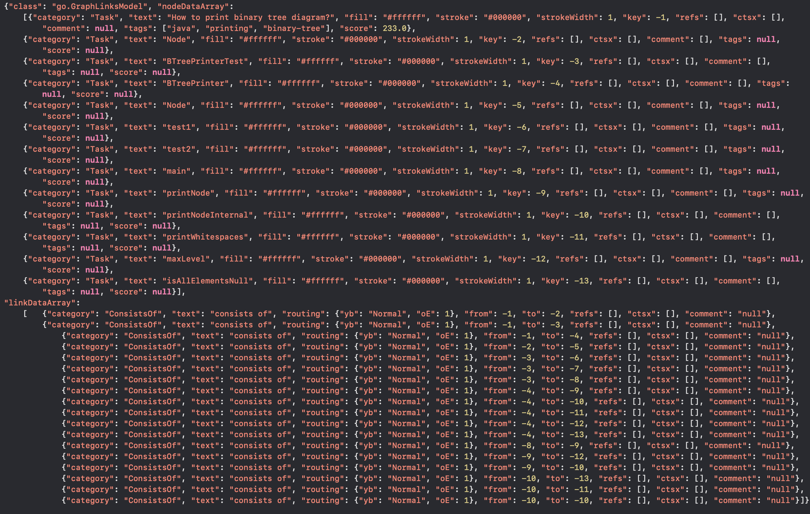
Example 3 – Json(without code and text)

Slide 22
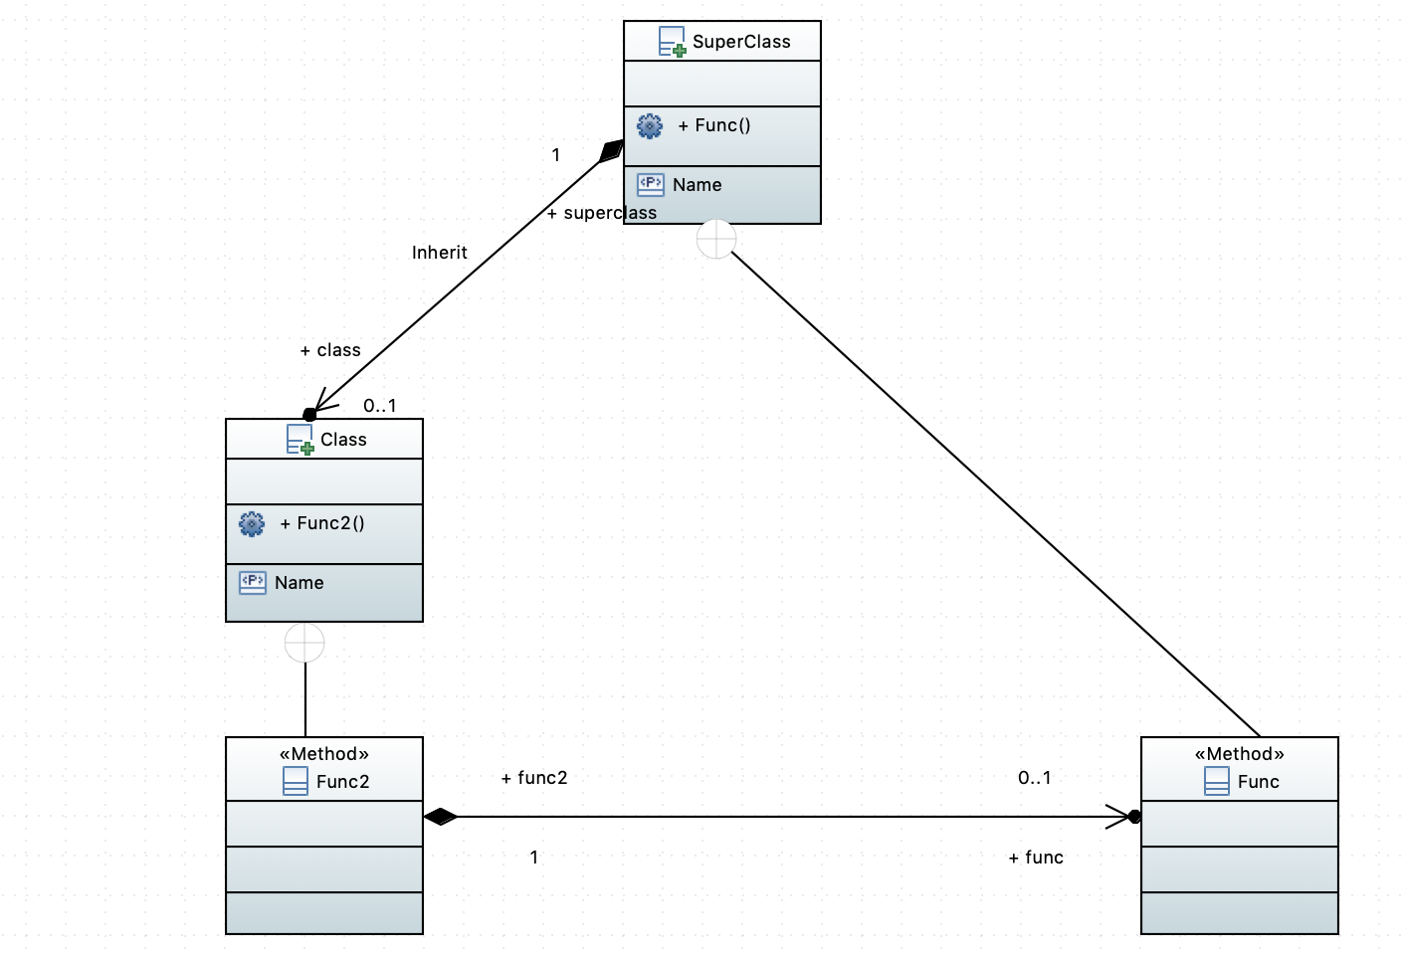
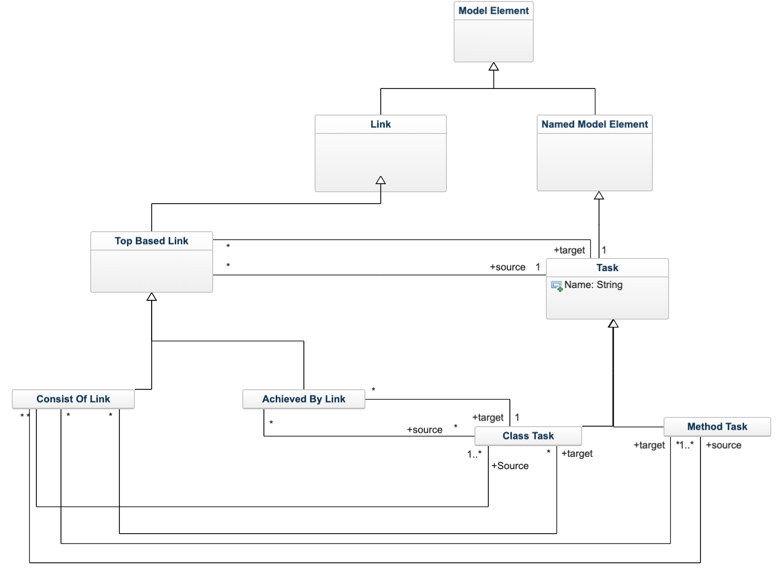
Rules
Every java code can be modeled as UML model to represents its meta model, also the mapping has its own model with its own meta model.
In order to transform each model, I’ve written rules for meta model transformation using Eclipse epsilon framework.

Slide 23
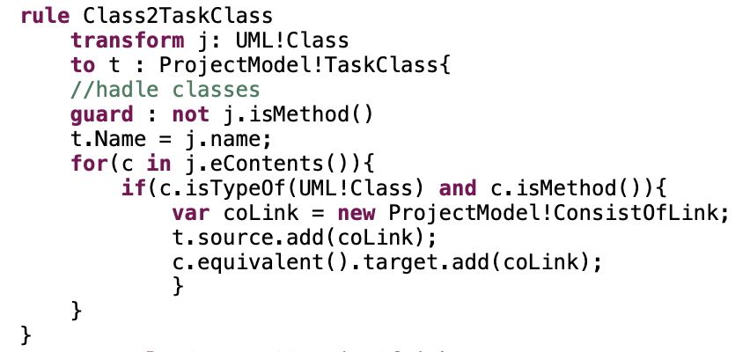
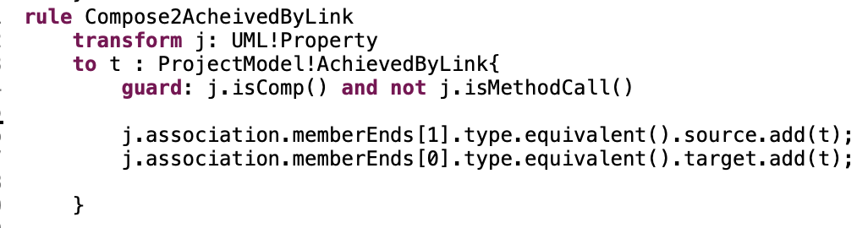
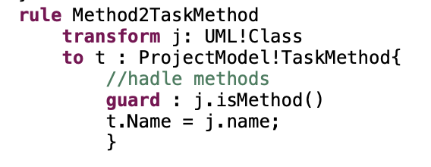
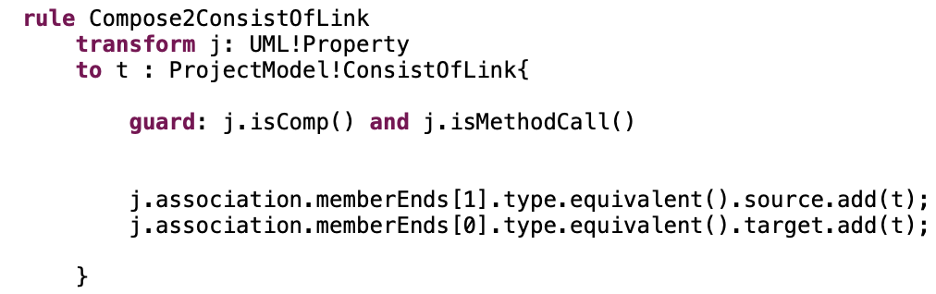




Rules
Class $→$ Class Task:
Compose $→$ Achieved By Link:
Method $→$ Method Task:
Compose $→$ Consist Of Link:

Slide 24
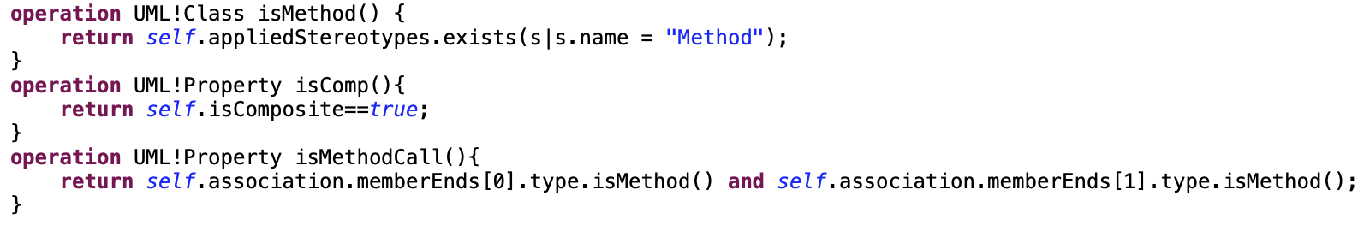
Rules – additional operations

Slide 25
Further work
Connect each post to its stack overflow page.
Handle non- compiled java codes.
Add the mapping to References, Contexts and talkback in khmap.
Reduce the mapping’s json.
Answer codes that switch the original code with “…”
Overloading methods.
Enhance memory usage (threading).

